Slide 1





https://www.linkedin.com/in/bhagyashri-shendge-5208441b2

Slide 2

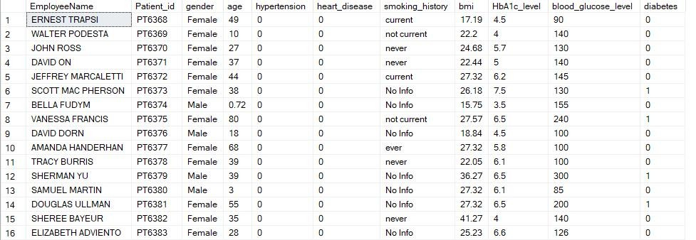
Note: Column ‘EmployeeName’ should be renamed to ‘Patient_Name’

Slide 3
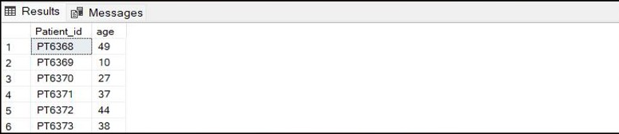
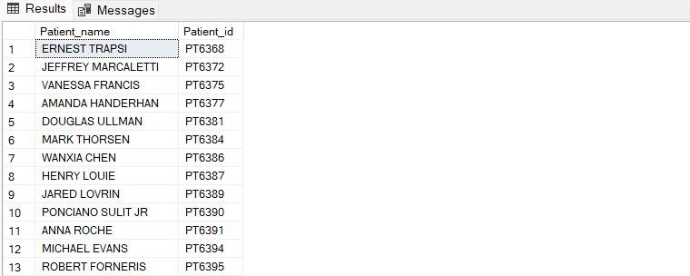
select Patient_id,age from Diabetes_prediction
1. Retrieve the Patient_id and ages of all patients.
2. Select all female patients who are older than 30
Select Patient_name,Patient_id from Diabetes_prediction
where gender='Female' and age>40

Slide 4

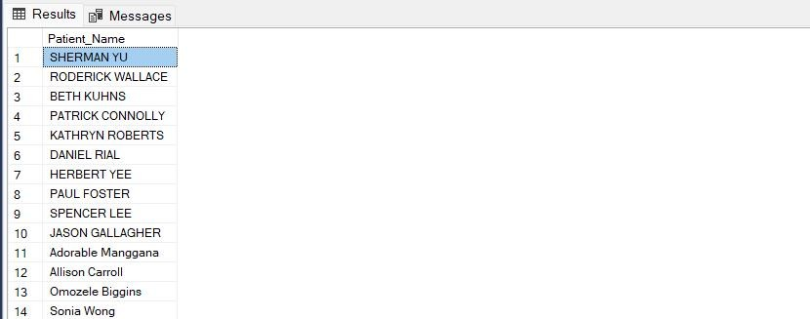
3. Calculate the average BMI of patients.
4. List patients in descending order of blood glucose levels.
select Patient_Name
from Diabetes_prediction
order by blood_glucose_level desc
select avg(bmi) as Average_BMI from Diabetes_prediction

Slide 5
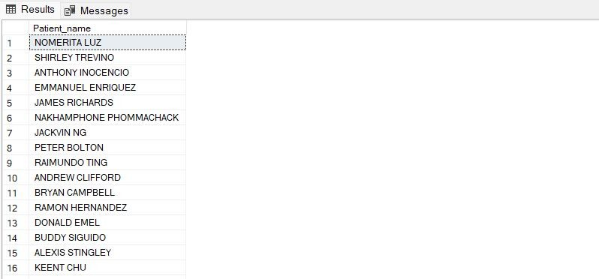
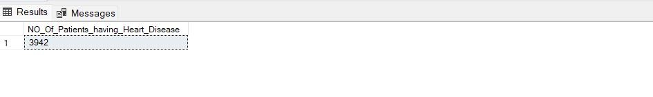
5. Find patients who have hypertension and diabetes.
6. Determine the number of patients with heart disease.
select Patient_name
from Diabetes_prediction
where hypertension <> 0 and diabetes<>0
select count(Patient_id) as NO_Of_Patients_having_Heart_Disease from Diabetes_prediction
where heart_disease<>0

Slide 6
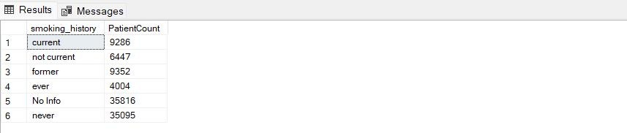
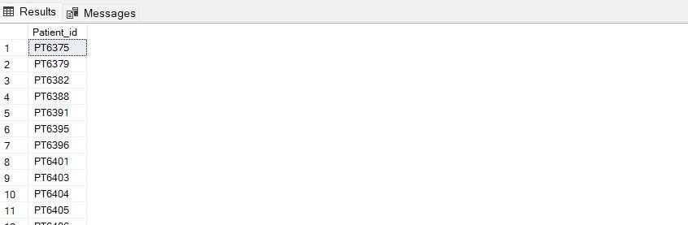
7. Group patients by smoking history and count how many smokers and nonsmokers there are.
8. Retrieve the Patient_ids of patients who have a BMI greater than the average BMI.
SELECT smoking_history, COUNT(*) AS PatientCount
FROM Diabetes_prediction GROUP BY smoking_history;
select Patient_id
from Diabetes_prediction
where bmi>(select avg(bmi) from Diabetes_prediction)

Slide 7
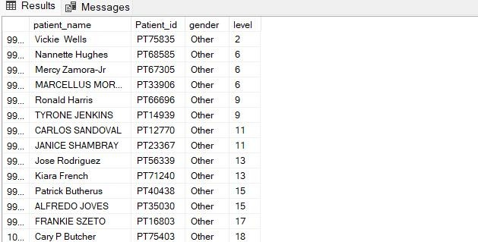
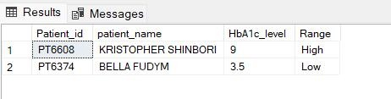
10. Calculate the age of patients in years (assuming the current date as of now).
-- Birth date is not availavle to perform the task
9.Find the patient with the highest HbA1c level and the patient with the lowest HbA1clevel.
with high as
(SELECT TOP 1
Patient_id,patient_name,HbA1c_level,
case when HbA1c_level=HbA1c_level then 'High’ end as Range
FROM Diabetes_prediction ORDER BY HbA1c_level DESC),
low as
(SELECT TOP 1
Patient_id,patient_name,HbA1c_level,
case when HbA1c_level=HbA1c_level then 'Low’ end as Range
FROM Diabetes_prediction ORDER BY HbA1c_level ASC)
select * from high union
select * from low
order by HbA1c_level desc
11. Rank patients by blood glucose level within
each gender group.
select patient_name,Patient_id,gender, rank() over(partition by gender order by blood_glucose_level) as level
from Diabetes_prediction

Slide 8
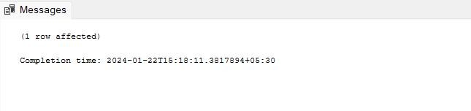
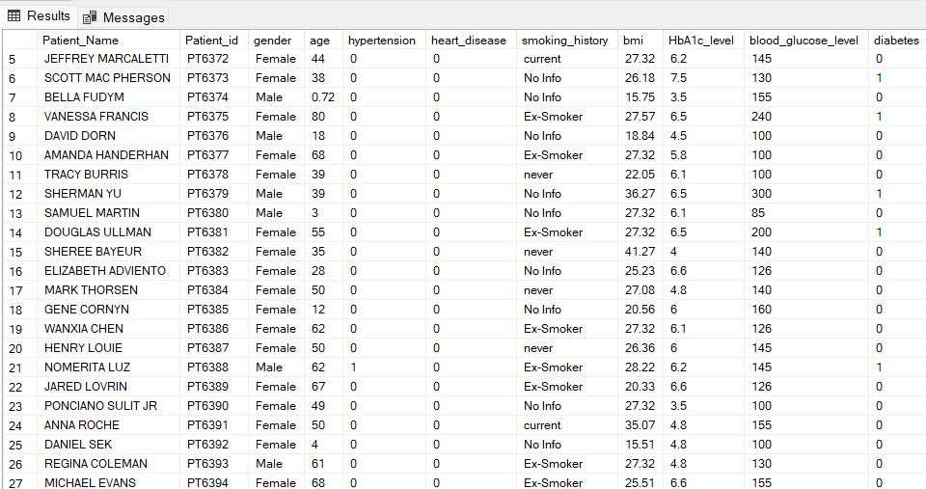
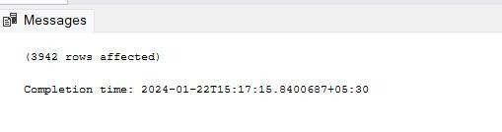
12. Update the smoking history of patients who are older than 50 to "Ex-smoker.
13. Insert a new patient into the database with sample data.
update Diabetes_prediction
set smoking_history = 'Ex-Smoker' where age>50
select*from Diabetes_prediction
insert into Diabetes_prediction values ('Shalini
Kurup','IasdZE','Female',23,0,0,'Current ',30,10,300,1)
14. Delete all patients with heart disease from the database.
delete from Diabetes_prediction where heart_disease=1

Slide 9
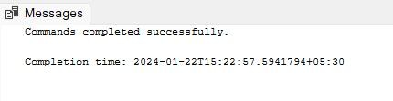
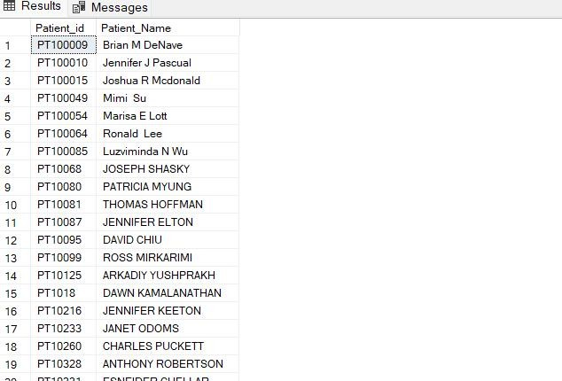
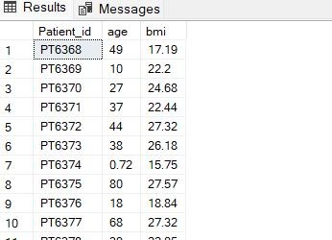
15.Find patients who have hypertension but not diabetes using the EXCEPT operator.
16. Define a unique constraint on the "patient_id" column to ensure its values are unique.
select Patient_id,Patient_Name from Diabetes_prediction
where hypertension=1 except
select Patient_id,Patient_Name from Diabetes_prediction
where diabetes=1
ALTER TABLE Diabetes_prediction
ADD CONSTRAINT UC_PatientID UNIQUE (patient_id);
17. Create a view that displays the Patient_ids, ages, and BMI of patients.
create view Display as select Patient_id,age,bmi from Diabetes_prediction select * from Display

Slide 10



18. Suggest improvements in the database schema to reduce data redundancy and improve data integrity.
Ensure that the database is normalized to reduce data redundancy. Break down large tables into smaller ones, and use relationships to link them. For instance, if patient details are repeated in multiple tables, consider having a separate table for patient information linked by a unique patient ID.
Implement foreign keys to establish relationships between tables. For example, if there is a table for medical records and another for patients, use a foreign key in the medical records table that references the unique patient ID in the patients' table.
Optimize data types for columns. Use the most efficient data type that accurately represents the data. This helps in reducing storage requirements and improves query performance.
Remove any redundant columns that can be derived from other columns. For instance, if age can be derived from the birthdate, consider calculating it dynamically instead of storing it separately.
Maintain consistent naming conventions across tables and columns for better
readability and maintainability.

Slide 11







19. Explain how you can optimize the performance of SQL queries on this dataset.
Identify columns frequently used in WHERE clauses and JOIN conditions and create indexes on those columns. This significantly improves the speed of search operations.
: Review and optimize the SQL queries. Avoid using `SELECT *` if not necessary; only fetch the columns needed. Analyze the execution plan and optimize where necessary.
If the dataset is large, consider partitioning tables. This can enhance query performance by allowing the database engine to skip partitions that are not needed for a specific query.
Implement caching mechanisms to store frequently accessed query results. This reduces the load on the database server for repeated queries.
Schedule regular database maintenance tasks, such as updating statistics, rebuilding indexes, and optimizing queries. This ensures the database stays performant over time.
Instead of sending raw SQL queries from the application, use stored procedures. This allows the database engine to optimize the query plan and reuse it for subsequent calls.
If certain complex queries are executed frequently and involve aggregations or joins, consider using materialized views. These precomputed views can significantly improve query performance.
If possible, consider upgrading hardware resources such as RAM, CPU, or SSD to improve overall database performance.
Implementing these improvements requires a careful analysis of the specific dataset, application requirements, and usage patterns. It's recommended to thoroughly test any schema changes or optimizations in a controlled environment before applying them to a production database.

